Slide 1
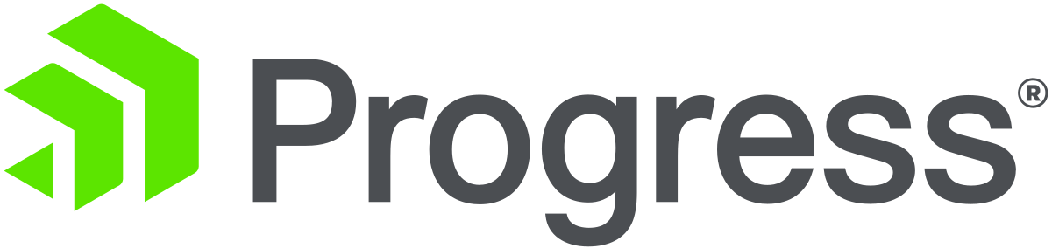
Voyago – with KendoReact
By KendoReact Wissam

Slide 2

The Project and React
Voyago is an ecommerce website which allows buying bikes, components and accessories.
React is an open source component-based javascript library maintained by Meta.

Slide 3

KendoReact Components
I used multiple KendoReact components such as:
-Card
-ListView
-GridLayout
-ScrollView
-Data query (sortBy tool)
-Badge
-DropDowns (Autocomplete and DropDownList)
-Pager
-Slider

Slide 4

React Hooks and Tools
I was using functional components, and thus used hooks.
The hooks I used the most are:
-useState
-useCallback
-useEffect
React tools:
-useLocation, useNavigate, Link, Router from react-router-dom

Slide 5

Other tools
Tools I used from npm:
- Buffer
react-client-session
Axios

Slide 6
How is the Project Working
I have two folders:
A folder for the client which contains all my UI and a folder for the server which contains all the routes.
The client runs on port 3000 while my server runs on port 5000.
The client makes requests to the server using axios, which allows all kinds of HTTP requests (POST,GET,etc..)
The server-side, which is connected to the SQL SERVER, executes the query and returns the result.

Slide 7
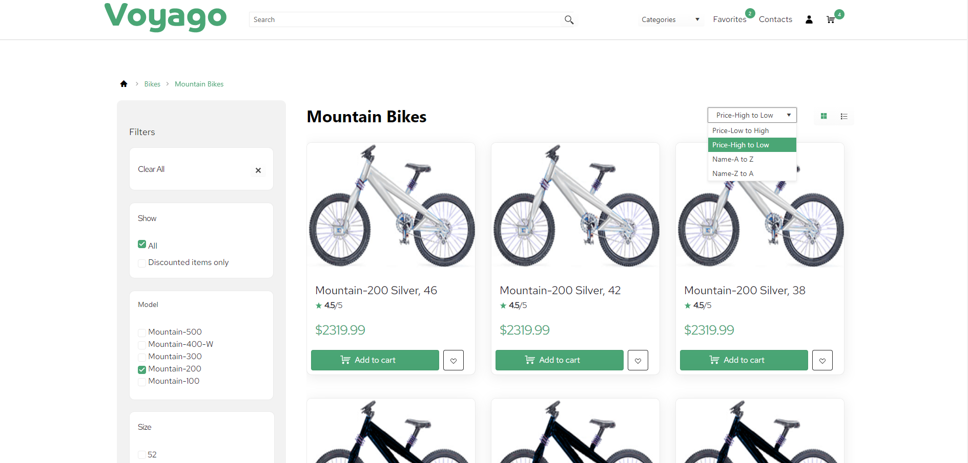
Project Demo

Slide 8
WebSearch Extension
-Systems.Diagnostic.Process for external search
-DteInstance instance to access the project references
-InfoBarService.Instance.ShowInfoBar to show the infobar

Slide 9
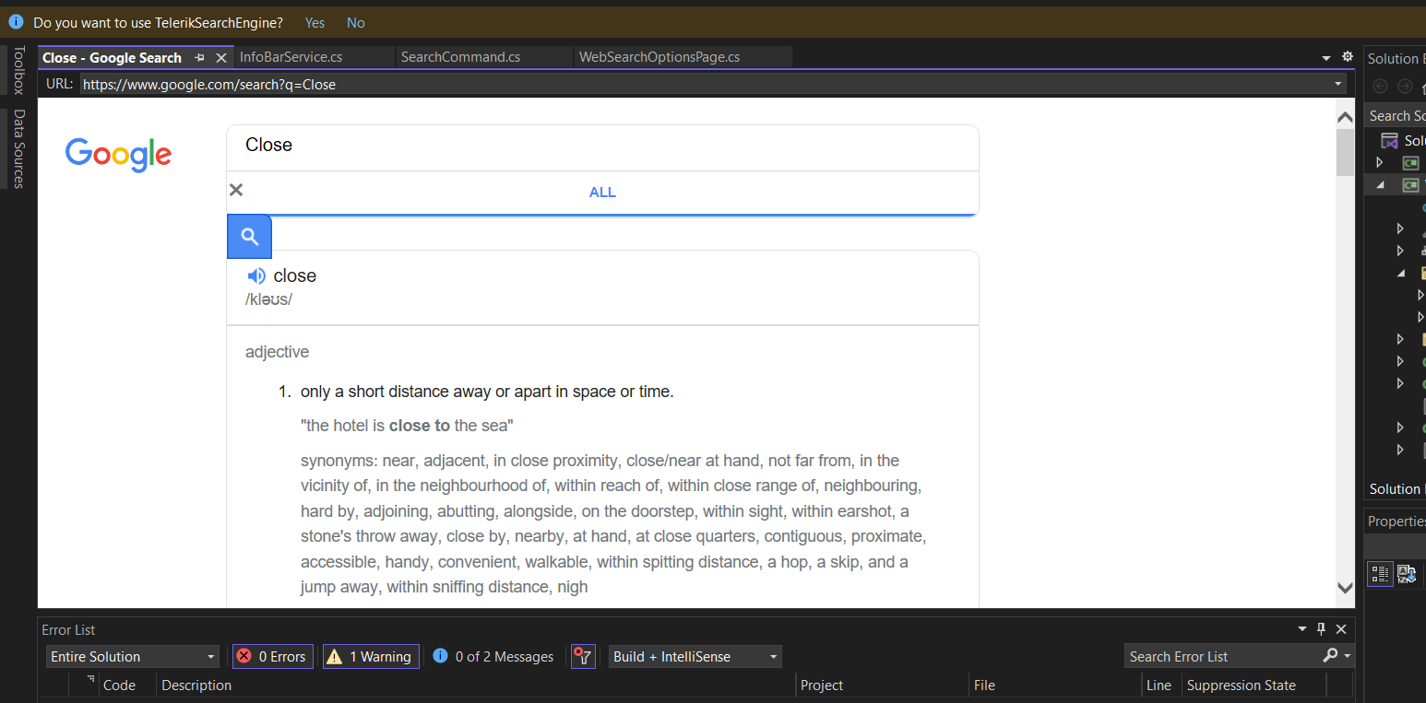
WebSearch Demo

Slide 10
Conclusion

